Slide 1
New Corp. Site Launch in 2015
Digital Marketing Center
IT
Web Design
Gary.Lee / Vicky.Huang
Jack.Lin / Toby.Fan
Fox.Chung / Jayson.Chiang
Angie.Lu / Sally.Yang

Slide 2
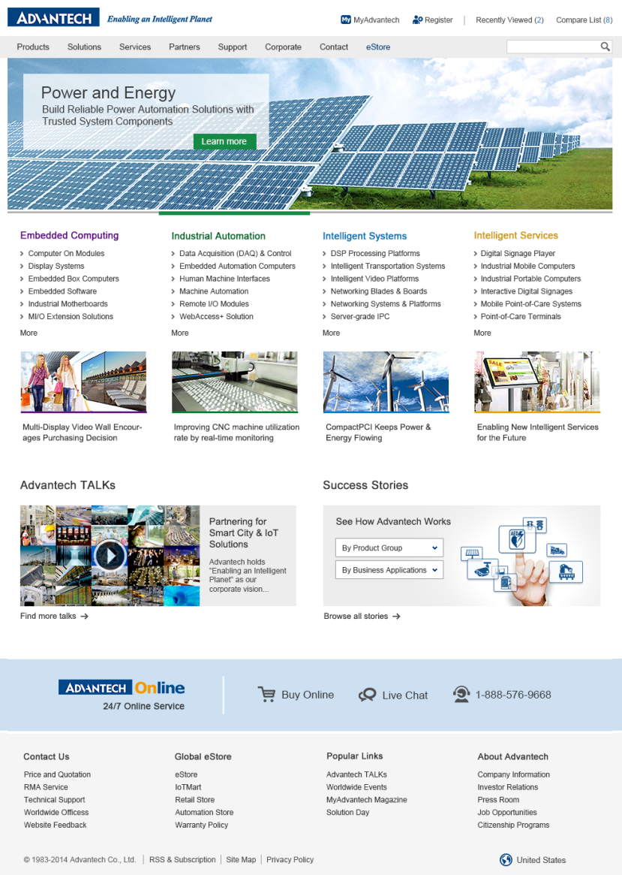
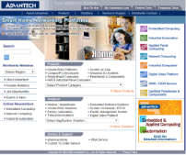
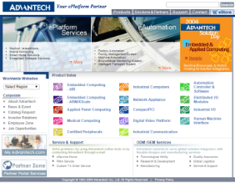
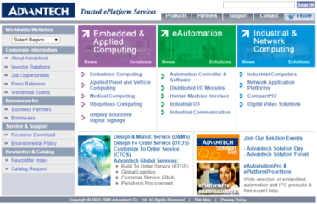
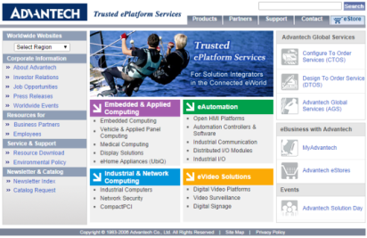
New Corp. Site Launch in 2015
2015
2002
2004
2006
2007
2010

Slide 3
Features of New Corp. Website
Personal Services
Provide personal services and attract new registrants.
Main Solutions (Big Banner)
Main solutions of 4BU. Quarterly update.
Main Products
Selection
Main Topics
Main topics of 4BU. Timely update and will be rotated.
Success Stories
Easily find all application stories and download here.
Video Zone
Link to Advantech TALKs, easily find professional videos about trends & solutions.
AOnline Services
Big Footer
Quick links access and language selection

Slide 4
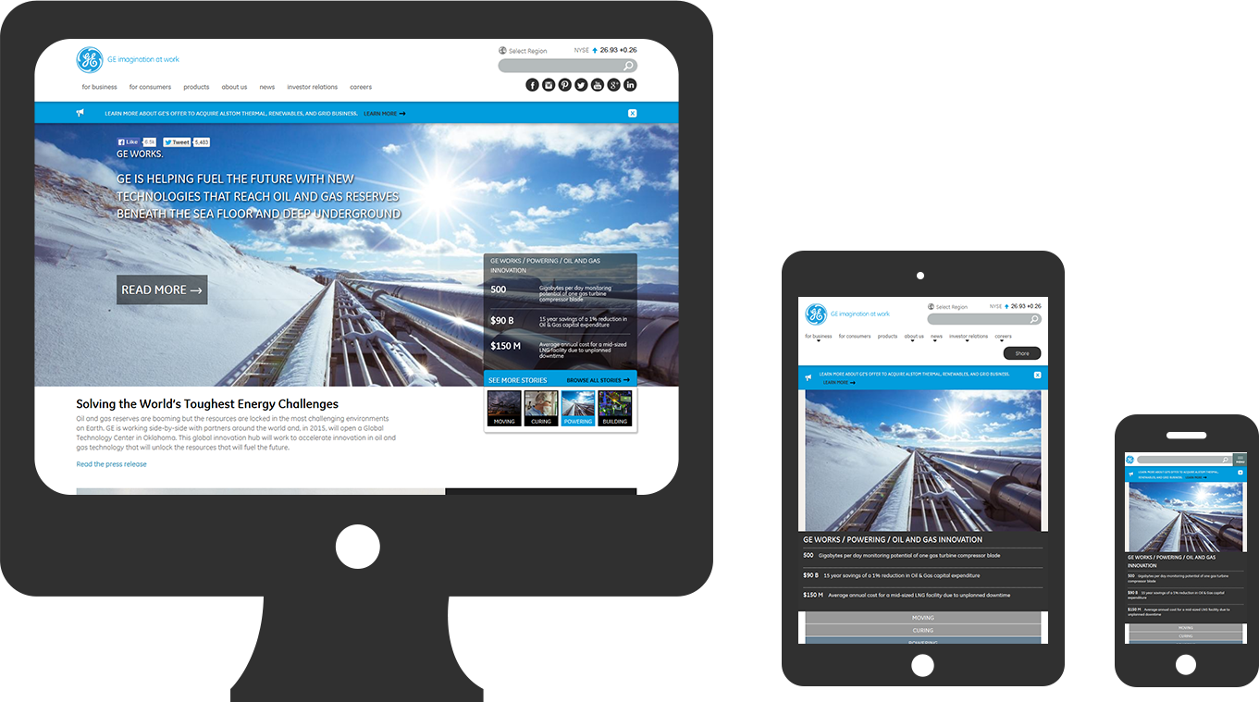
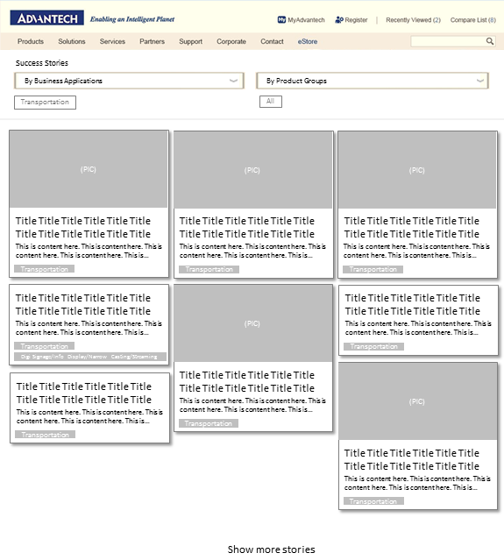
Features of New Breakthrough for 2015 New Corp. Site
Responsive Design
Provide an optimal viewing experience, easily navigate website across a wide range of devices.
New Functions
Provide personal services to help customer easily find our products, and willing to become online member.
Stage 2 launch in Jun. 2015
Fuzzy Search
Compare Products
Recently Viewed
Sign In / Sign Up
Cloud Platform
Backend system reconstruction. Cloud solution provide more stable environment and can serve more simultaneous online users 24/7 perfectly access.
Case Study Zone
Let customer easily find all application stories, download cases and contact AOnline sales.

